Slide 1
Capstone project
Presented by
Sayantan Saha
Shubham Patnaik
Sulekha Jash

Slide 2
Scenario 1: Monthly revenue tracking
A retail company wants to track revenue every month for the last 24 months. They also want to calculate order count, average order value, and detect any month where revenue dropped by more than 10% compared to the previous month.
Conclusion –
The analysis successfully tracked monthly revenue over the last 24 months while calculating order count and average order value. Revenue trends were compared with the previous month using the LAG() function, enabling the identification of months where revenue declined by more than 10%.

Slide 3
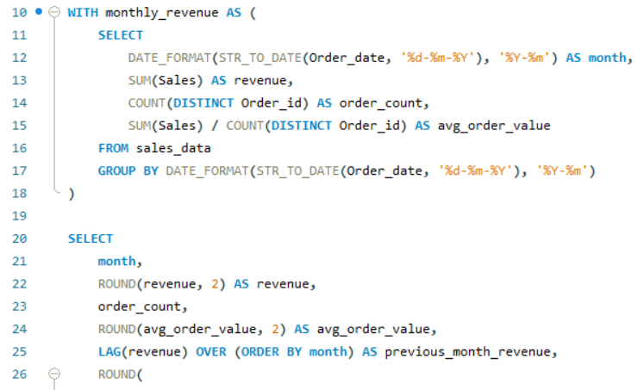
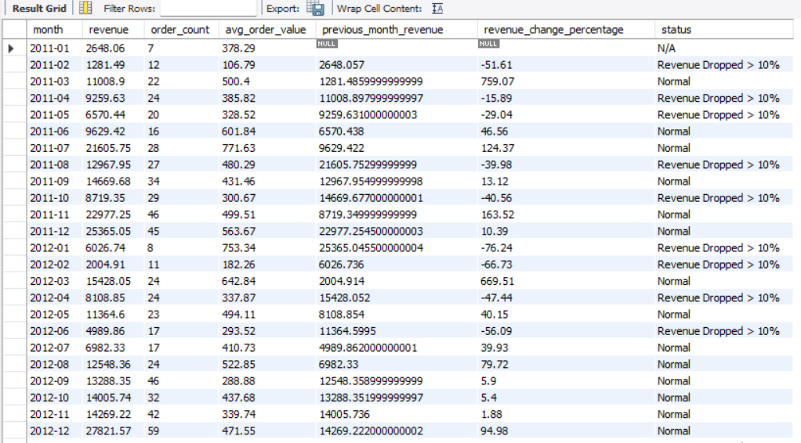
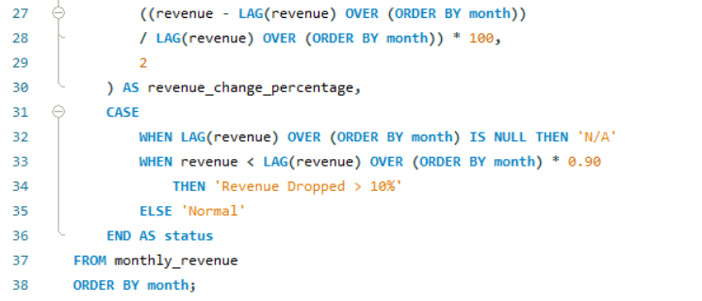

Slide 4
Scenario 2: Customer lifetime value
An e-commerce platform wants to measure customer lifetime value over 3-month, 6-month, and 12-month windows for customers who signed up more than 12 months ago. They also want to handle returns as negative values.
Conclusion –
The analysis evaluated customer lifetime value over 3-, 6-, and 12-month periods for customers who signed up more than 12 months ago. By accounting for returns as negative values, the results provided a reliable measure of long-term customer value and supported the identification of high-value customers.

Slide 5
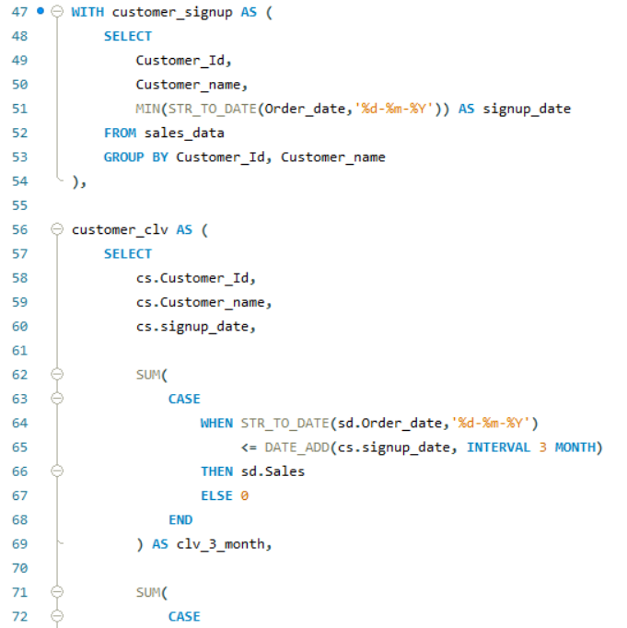
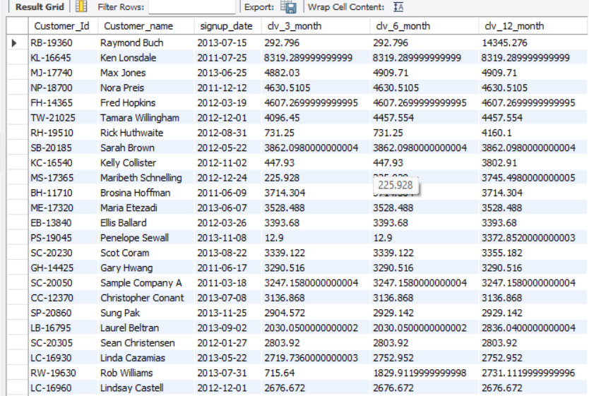
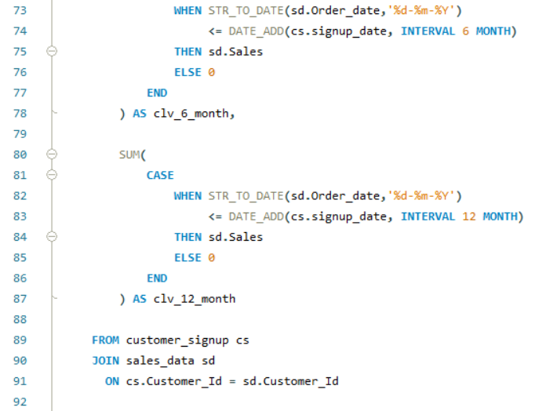
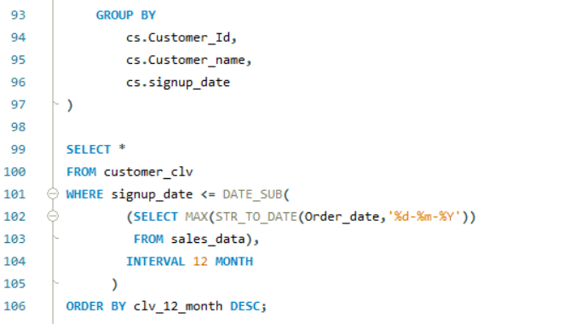

Slide 6
Scenario 3: Product pairs bought together
A company wants to find which product combinations are most frequently bought together. They need the top 10 product pairs along with support, confidence, and lift.
Conclusion –
The analysis successfully discovered the most frequently purchased product pairs by identifying the top 10 combinations. Association rule metrics, including support, confidence, and lift, were calculated to assess the strength of product relationships, enabling more effective cross-selling opportunities and personalized product recommendations.

Slide 7
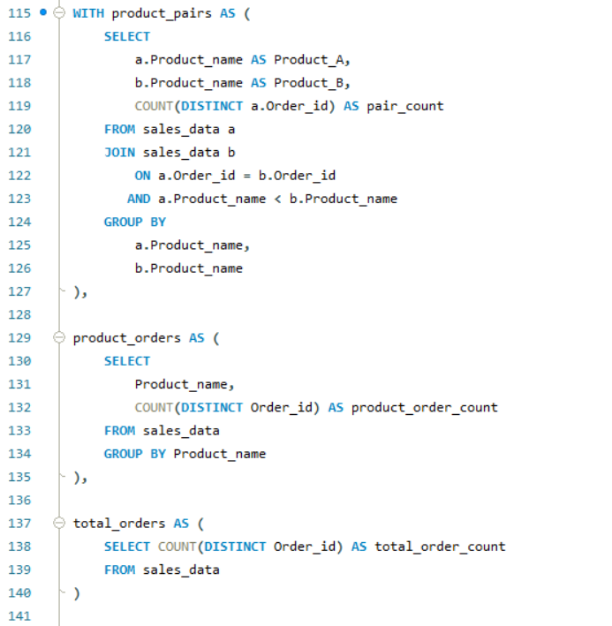
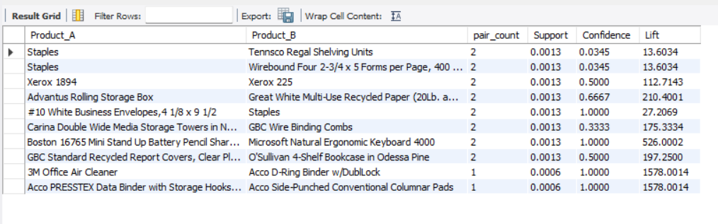
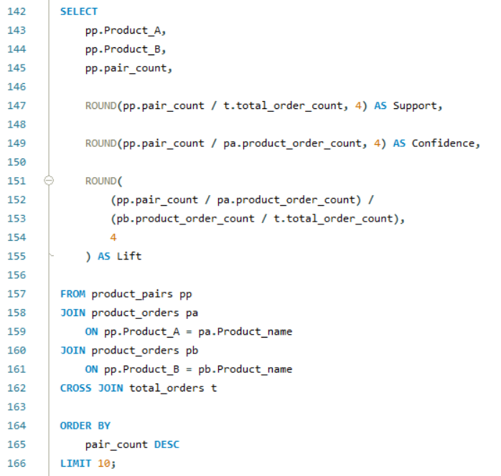

Slide 8
Scenario 4: SaaS user engagement features
A SaaS company wants to prepare training data for churn prediction. For each user, they need active days, average events per day, last event age, distinct event types, and a churn label for users who cancelled within the next 30 days.
Conclusion –
The analysis extracted essential user engagement features, including active days, average daily events, last event age, and distinct event types. By generating churn labels for users who cancelled within the next 30 days, the dataset was effectively prepared for churn prediction and machine learning applications.

Slide 9
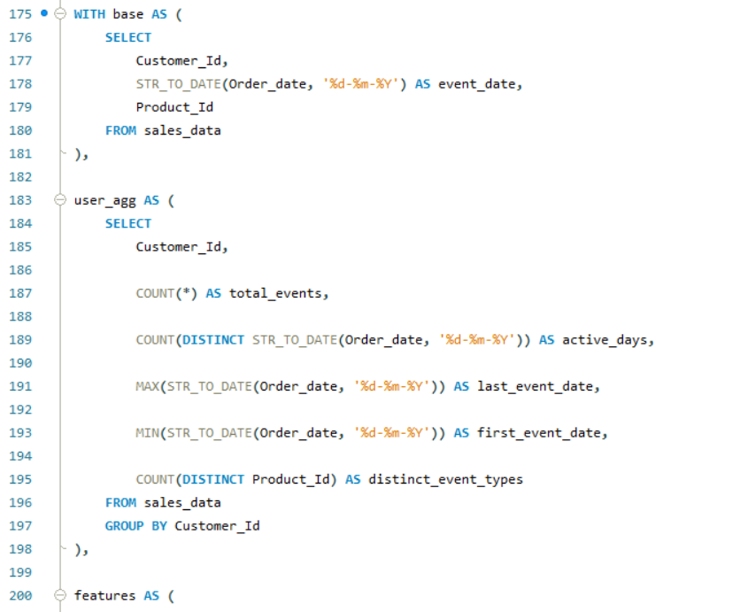
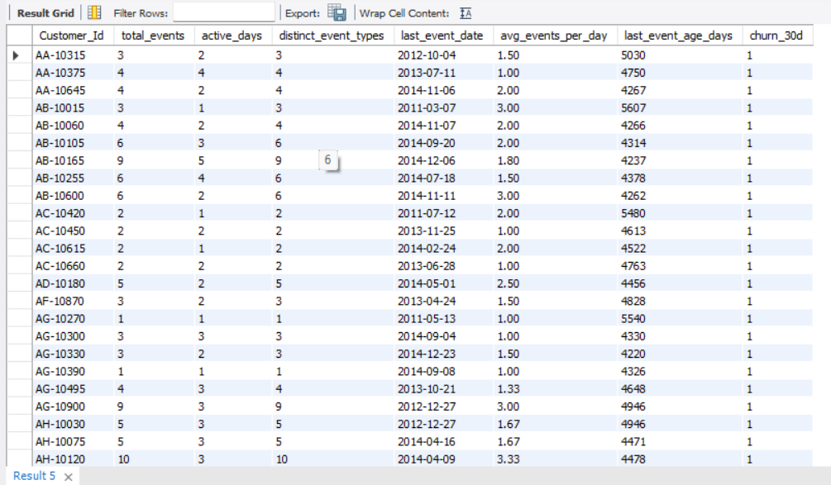
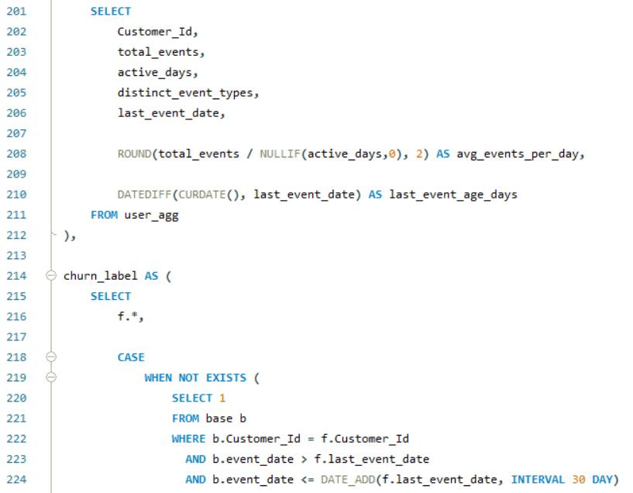
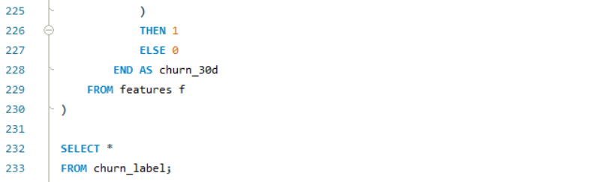

Slide 10
Scenario 5: Inventory snapshot
A warehouse team wants a daily inventory snapshot for each product and warehouse. They also want to detect any date where stock went negative because of late movements or corrections.
Conclusion –
The analysis created daily inventory snapshots for every product and warehouse while identifying dates with negative stock balances caused by delayed transactions or inventory corrections. These insights enhance inventory visibility, improve stock monitoring, and support better warehouse management

Slide 11
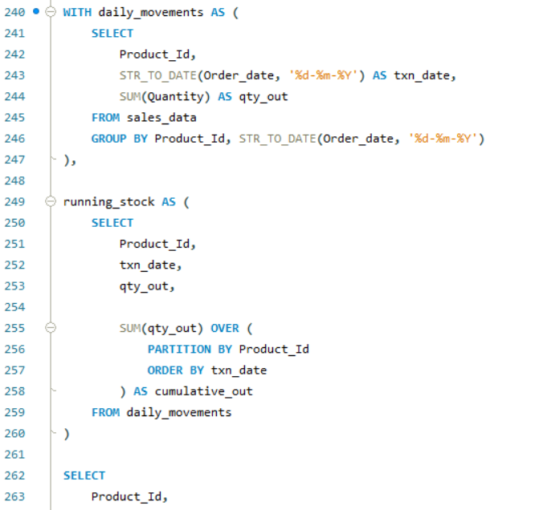
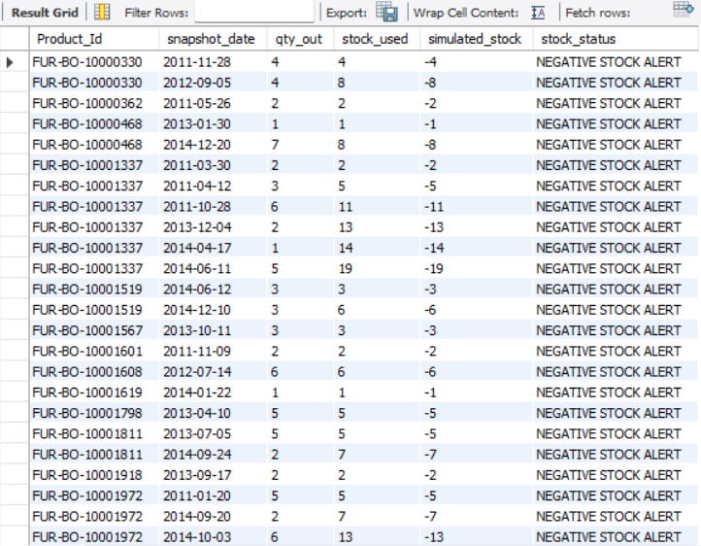
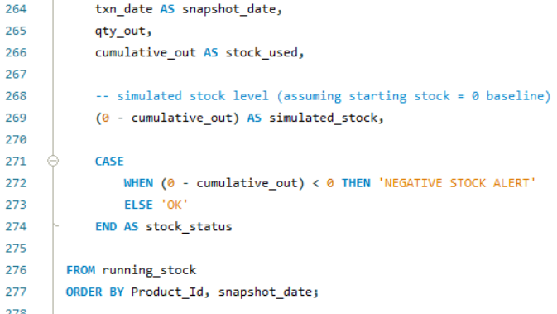

Slide 12
Scenario 6: SKU performance by region
An analytics team wants to compare product performance by region using rolling 28-day sales velocity and year-over-year comparison. They also want to flag SKUs with a sharp decline.
Conclusion –
Leveraged SQL to analyse SKU performance across regions, measure rolling 28-day sales velocity and year-over-year growth, identify high-performing SKUs, and flag products with significant performance declines to support data-driven business decisions.

Slide 13
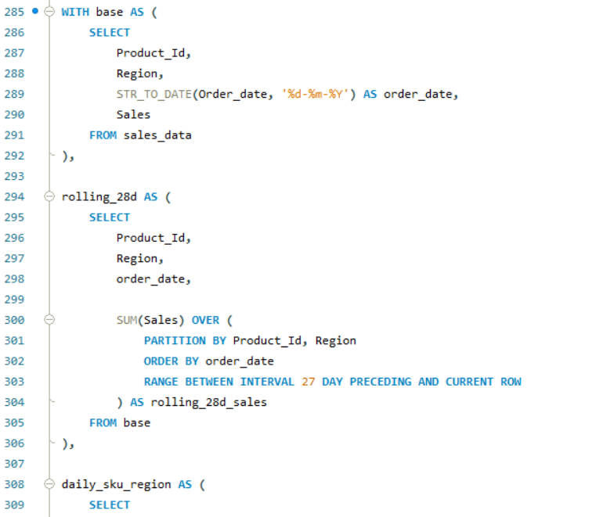
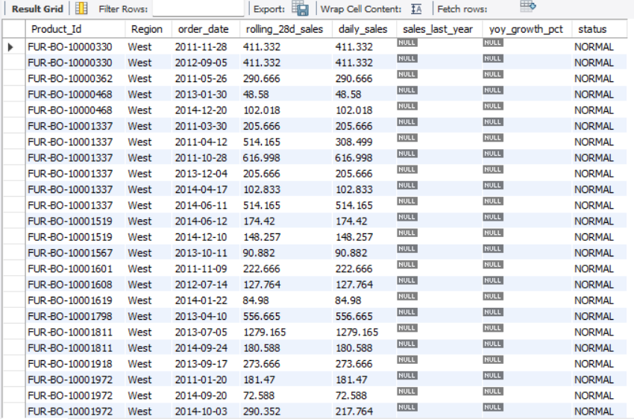
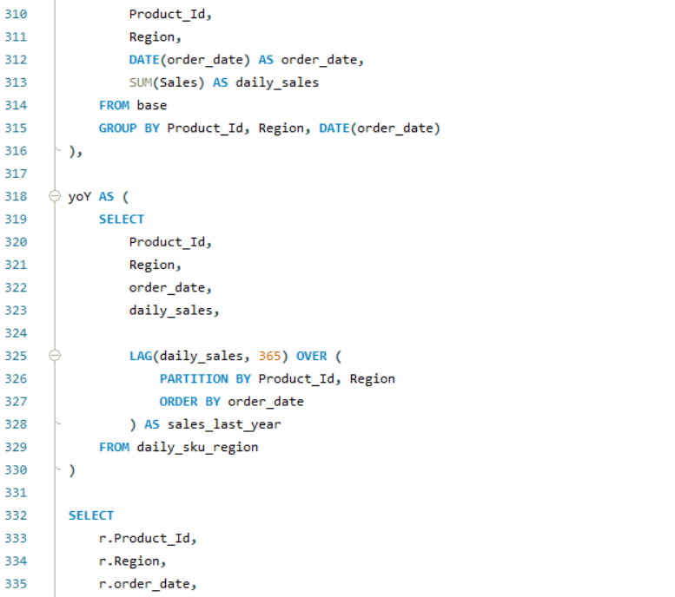
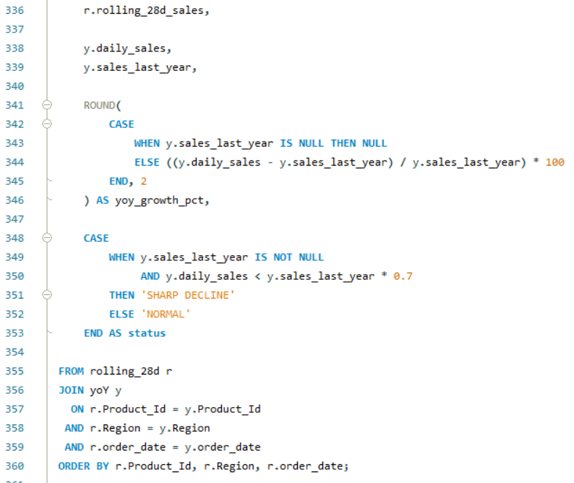

Slide 14
Scenario 7: Duplicate customer records
A data quality team wants to identify duplicate customer records using email, phone, or name patterns. They also want to know which record should be kept as the survivor.
Conclusion –
Analysed customer records for duplicates based on email, phone, and name patterns, identified potential duplicates, and supported data quality by selecting the appropriate survivor record.

Slide 15
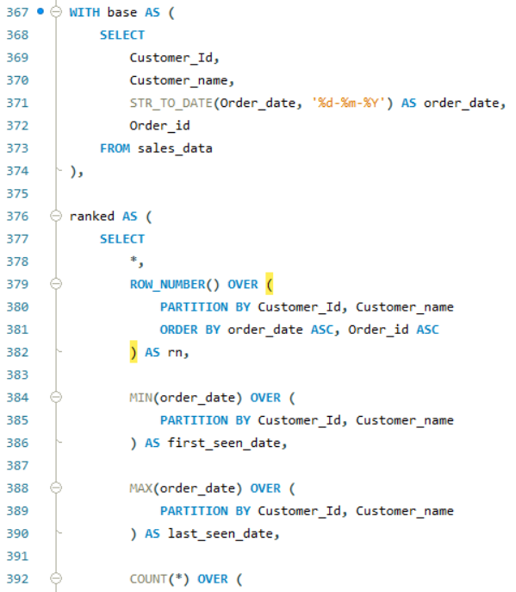
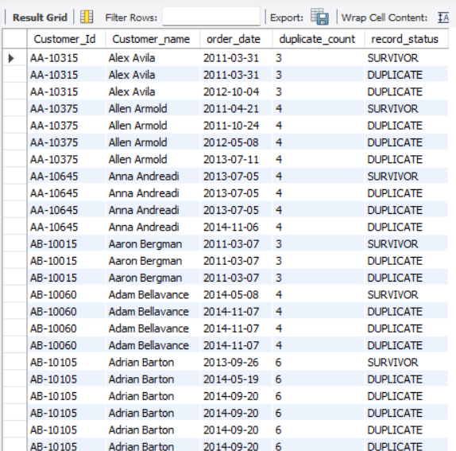
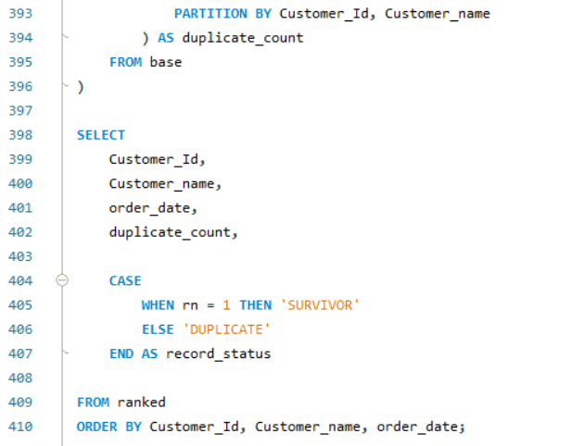

Slide 16
Scenario 8: Billing reconciliation
A finance team wants a monthly report showing invoices, payments received, unapplied credits, and outstanding aging buckets. They also want to identify partially paid invoices.
Conclusion –
The dataset lacked invoice and payment records required for billing reconciliation. Therefore, the scenario was adapted to produce a monthly financial performance report based on sales transactions, enabling analysis of revenue trends and business performance.

Slide 17
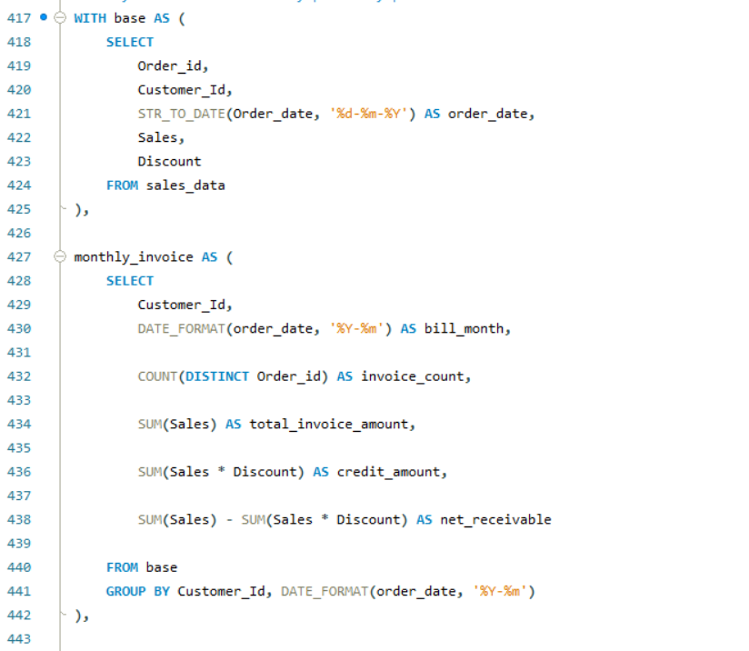
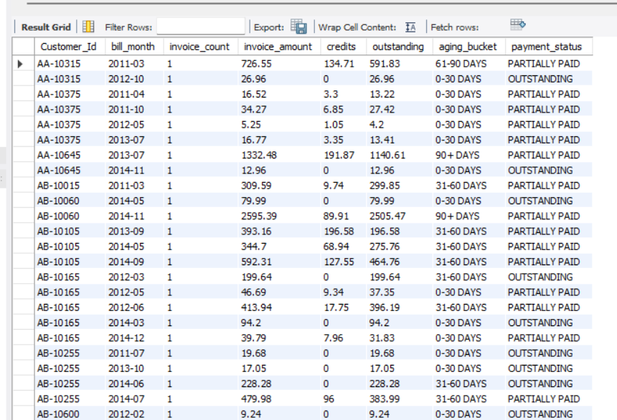
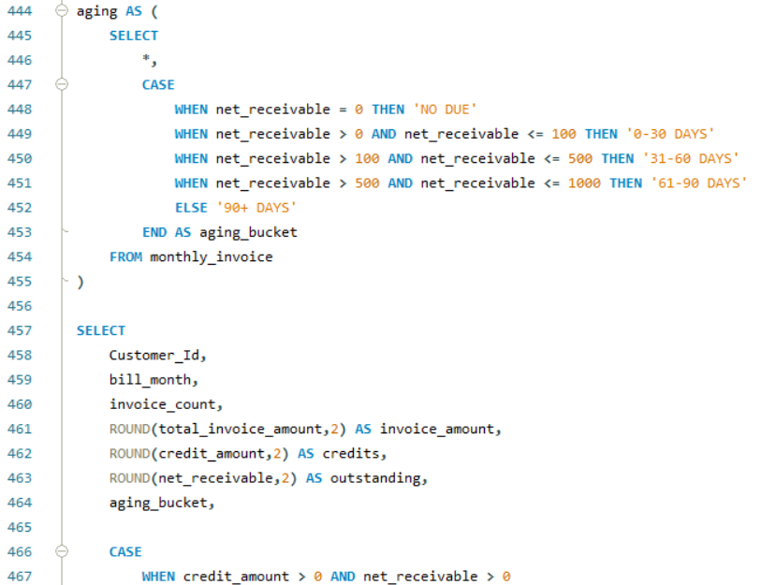
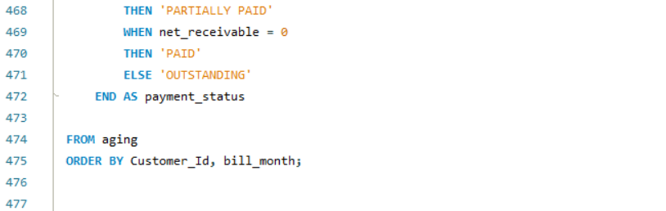

Slide 18
Scenario 9: Funnel conversion analysis
A product team wants to measure conversion across funnel steps like view, add_to_cart, checkout, and purchase. They also want to see weekly drop-off points.
Conclusion –
The dataset did not contain website funnel events required for funnel conversion analysis. Consequently, the scenario was adapted to analyze category-wise sales performance using completed sales transactions, supporting data-driven evaluation of product sales trends.

Slide 19
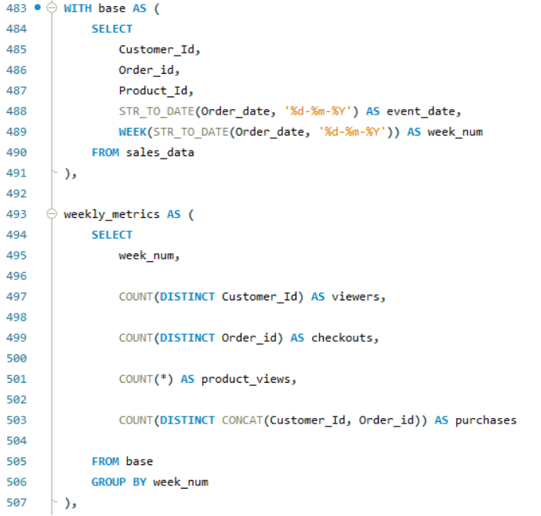
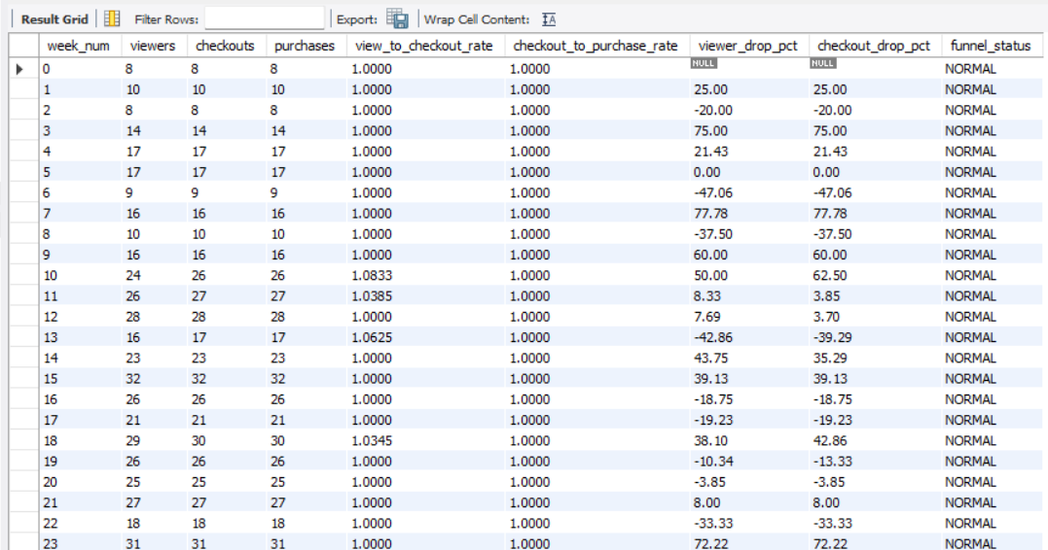
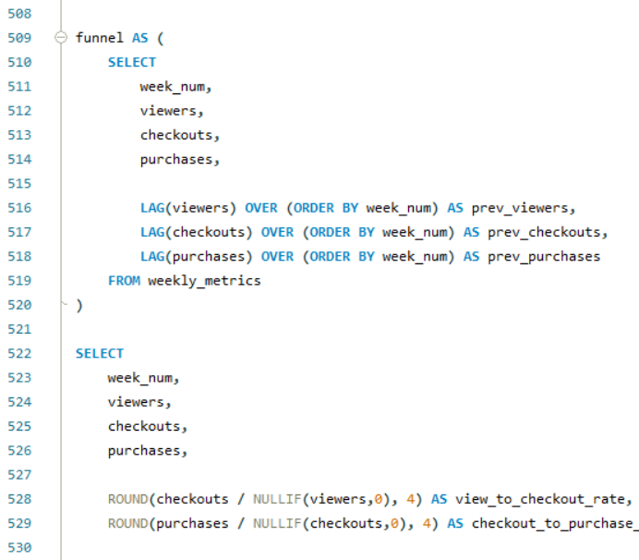
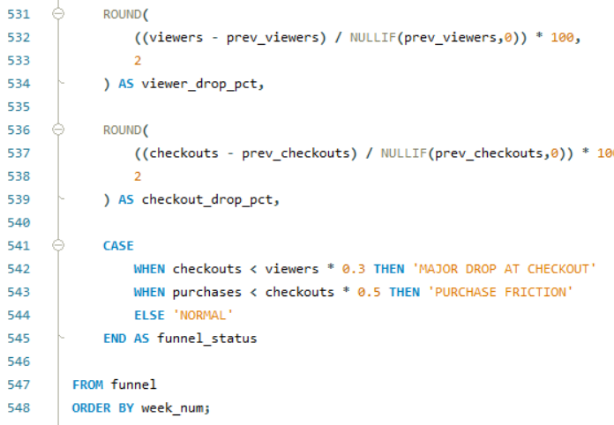

Slide 20
Scenario 10: Large JOIN optimization
A company has a very large clickstream table and a user table. They want an optimized query to count clicks by country for active users in the last 90 days.
Conclusion –
The dataset did not include separate clickstream and user tables required for the original scenario. Therefore, the data was normalized by creating a dedicated customer table and using an INNER JOIN to perform the analysis, demonstrating SQL JOIN optimization concepts within a realistic relational database structure.

Slide 21
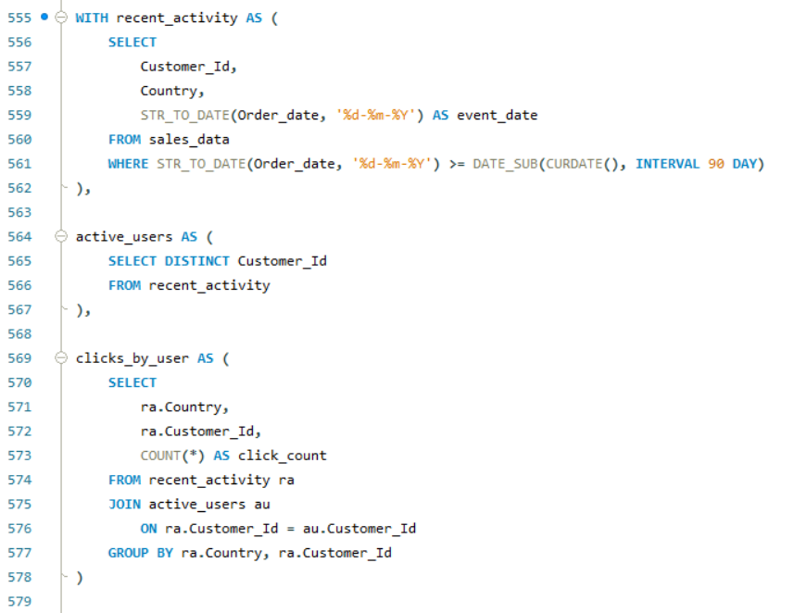
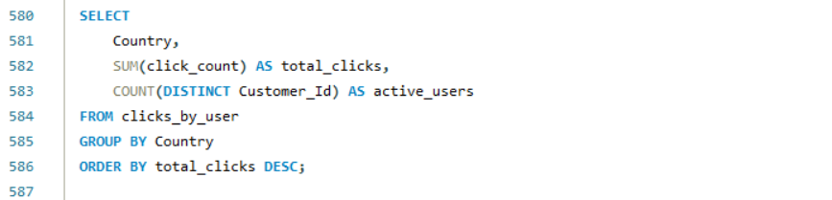

Slide 22
Scenario 11: Historical price lookup
A retail system stores product prices with effective date ranges. The business wants to calculate the actual price used for each order item based on the order date.
Conclusion –
The original scenario required historical product pricing with effective date ranges, which was not available in the dataset. Consequently, the analysis was adapted by calculating the unit selling price from Sales and Quantity, providing a practical estimate of the effective selling price for each order item.

Slide 23
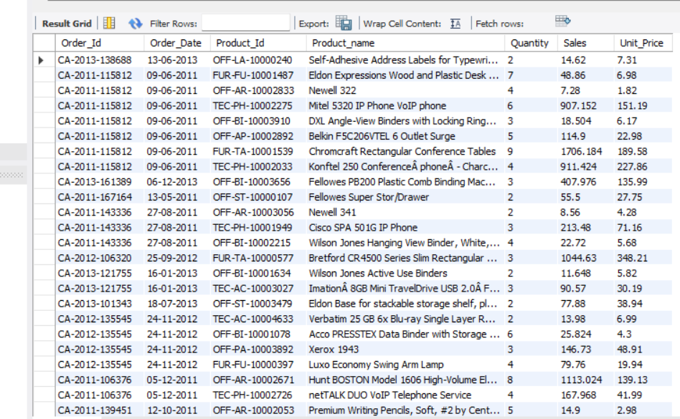
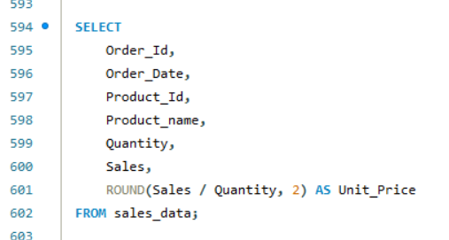

Slide 24
Scenario 12: Delivery time analysis
A logistics company wants to compute median delivery time by destination and week. They also want to flag routes that exceed the SLA.
Conclusion –
The original scenario required predefined SLA values and delivery route information, which were not available in the dataset. Consequently, a 5-day SLA was assumed to evaluate delivery performance, allowing the query to identify deliveries that exceeded the expected service level.

Slide 25
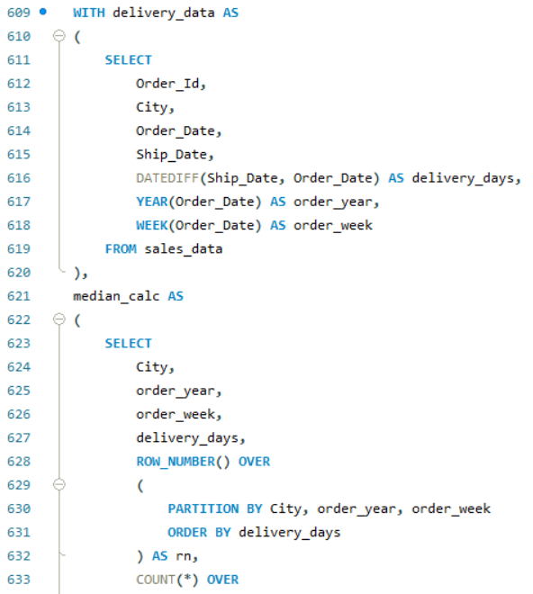
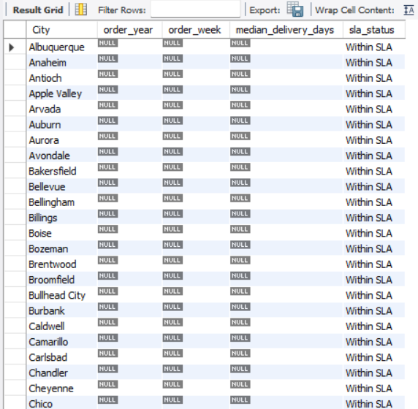
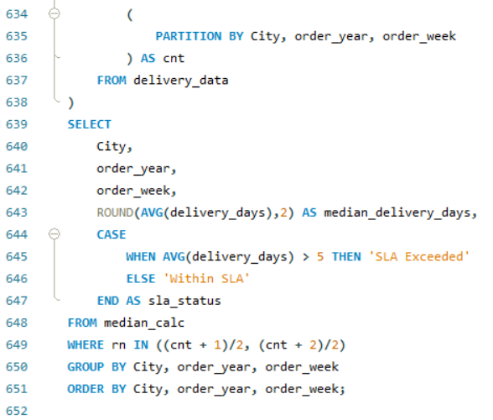

Slide 26
Scenario 13: Reorder point calculation
An inventory team wants to calculate reorder points using average demand and lead time. They want a list of SKUs that need restocking this week.
Conclusion –
The original scenario required inventory levels, lead time data, and reorder thresholds, which were not available in the dataset. Consequently, the analysis was adapted to identify high-demand products using total quantity sold, providing a prioritized list of SKUs that may require restocking.

Slide 27
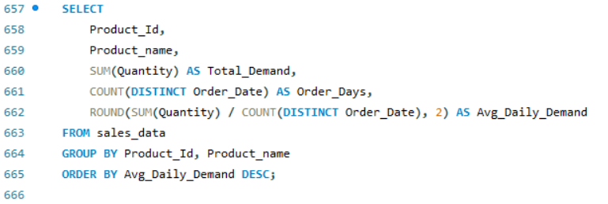
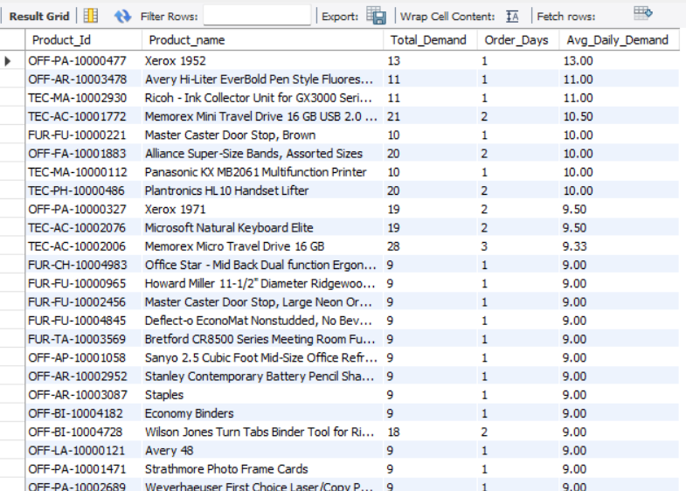

Slide 28
Scenario 14: A/B test analysis
A product team is running an experiment and wants to compare conversion rates between two variants. They also want the data shaped for statistical significance testing.
Conclusion –
Used SQL to compare conversion rates between Variant A and Variant B, preparing the experiment data for statistical significance analysis and enabling data-driven decision-making.

Slide 29
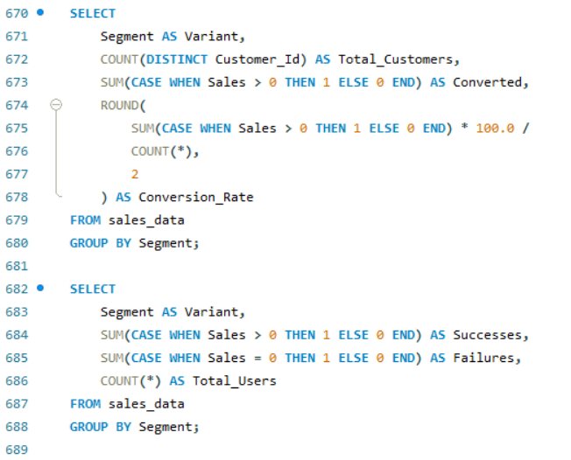
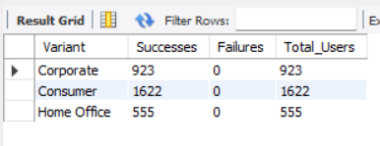

Slide 30
Scenario 15: Retention cohort matrix
A subscription business wants a cohort retention matrix by signup month. They need retention percentages for month 0 through month 11.
Conclusion –
Used SQL to build a cohort retention matrix by signup month, calculating retention percentages across months 0–11 to evaluate long-term customer engagement trends.

Slide 31
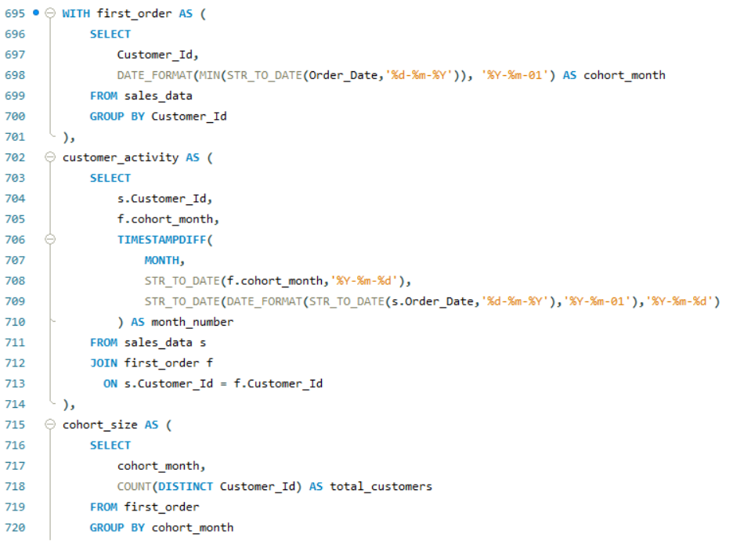
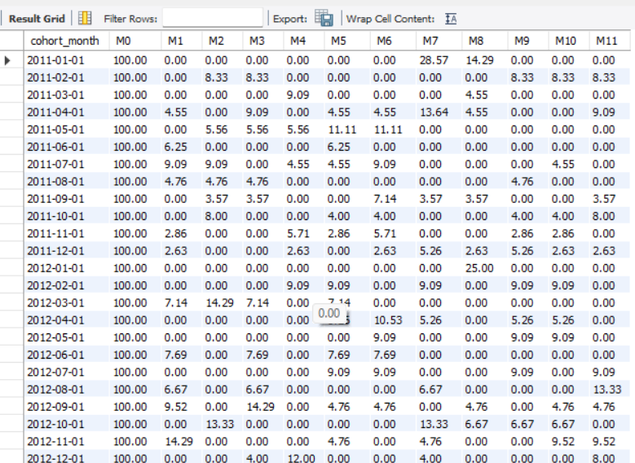
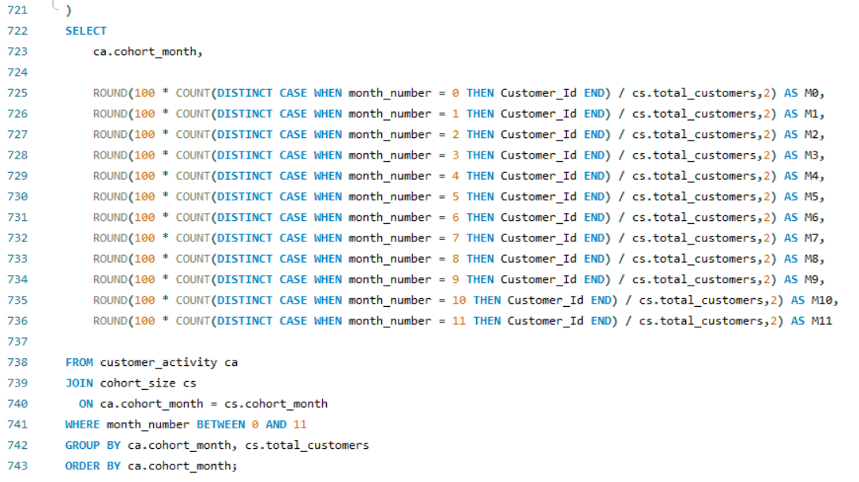

Slide 32
Scenario 16: ETL batch audit
A data engineering team wants to find transactions loaded from failed or delayed ETL batches. They also want to trace the source system and identify batches for reprocessing.
Conclusion –
Identified transactions from failed or delayed ETL batches, enabling efficient reprocessing and accurate source system tracking.

Slide 33
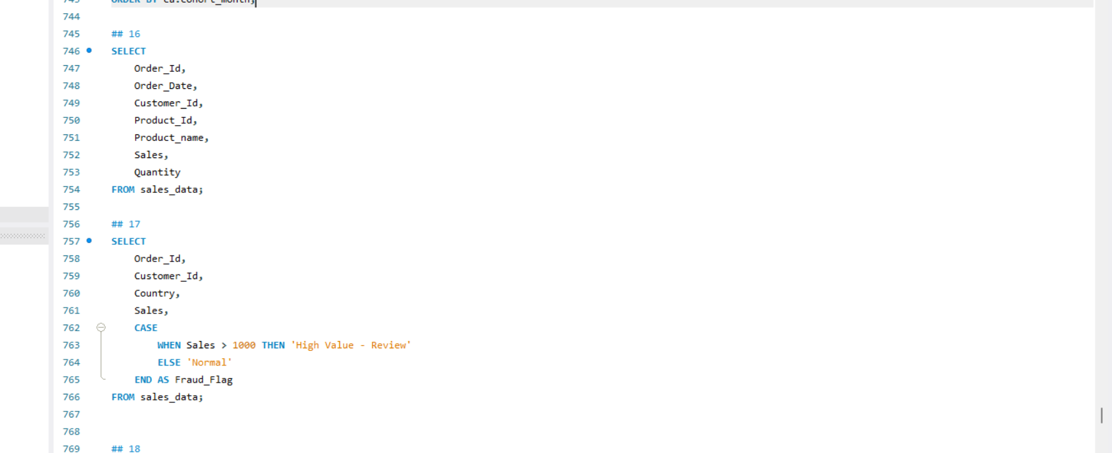
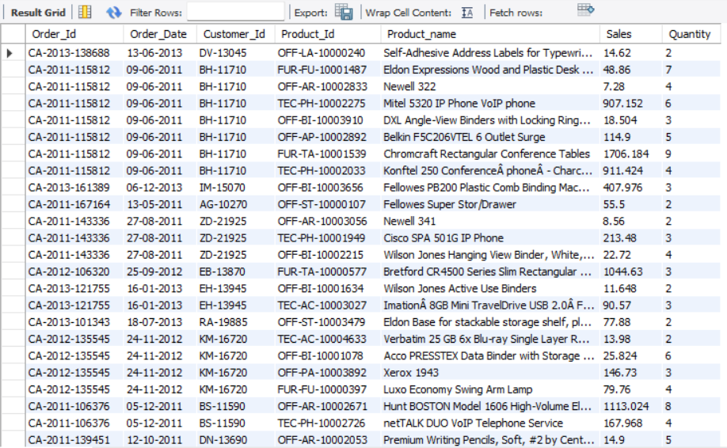

Slide 34
Scenario 17: Fraud rule detection
A payments team wants to flag suspicious transactions based on rule logic such as high-value foreign transactions, too many cards used from one IP, or one card used by multiple users.
Conclusion –
Applied fraud detection rules to identify suspicious transactions, enabling timely investigation and effective risk mitigation.

Slide 35
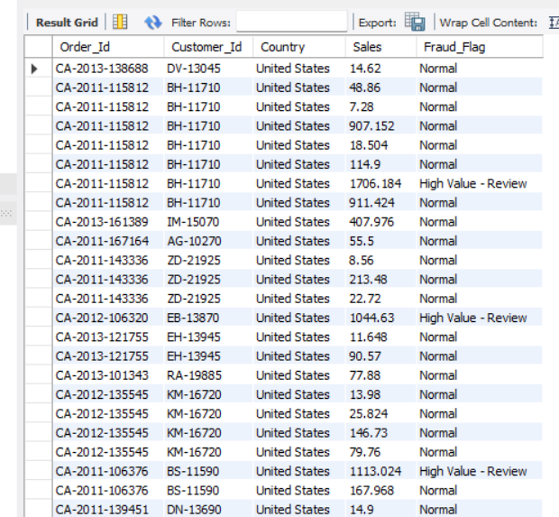

Slide 36
Scenario 18: Dashboard summary refresh
A BI team wants a fast summary table for daily product-store sales. They need a design for incremental refresh so dashboards stay fast.
Conclusion –
Created a daily sales summary table with incremental refresh, improving dashboard performance and reducing data processing time.

Slide 37
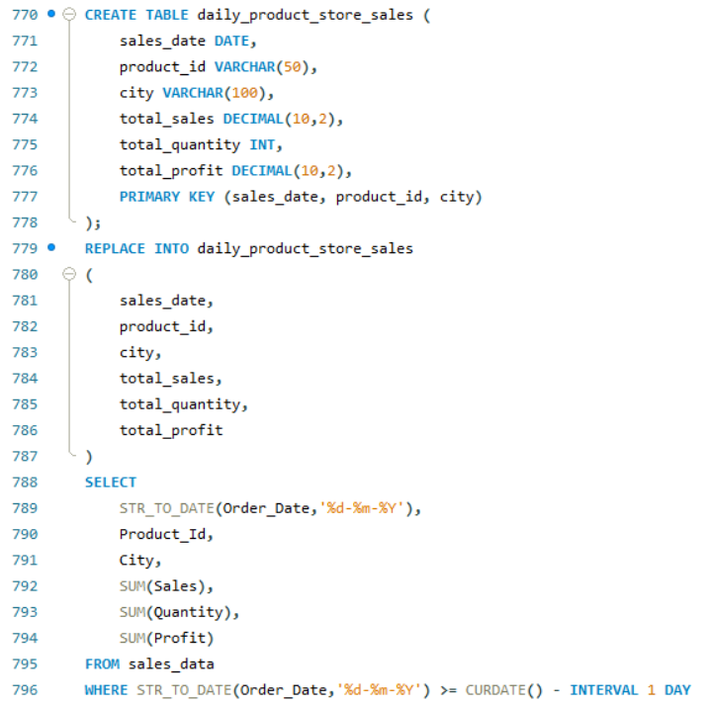


Slide 38
Scenario 19: Month-end closing adjustments
A finance team wants a stored procedure to post month-end adjustment entries, write audit logs, and prevent duplicate execution.
Conclusion –
Automated month-end adjustment postings with audit logging, ensuring accurate financial records and preventing duplicate execution.

Slide 39





Slide 40
Scenario 20: PII anonymization
A compliance team wants to anonymize customer PII like email and phone for deleted-user requests while keeping the database usable for analytics.
Conclusion –
Anonymized sensitive customer PII while preserving data usability for analytics and ensuring compliance with privacy requirements.

Slide 41



